Slide 1


Kevin Price
June 12, 2024

Slide 2

Outline
Executive Summary
Introduction
Methodology
Results
Conclusion
Appendix

Slide 3
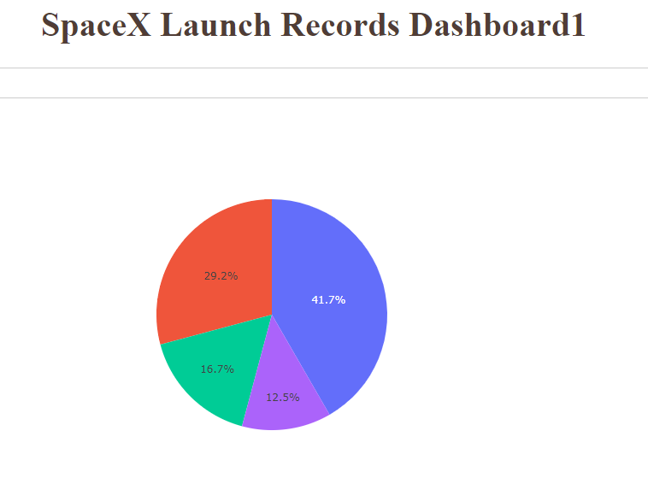
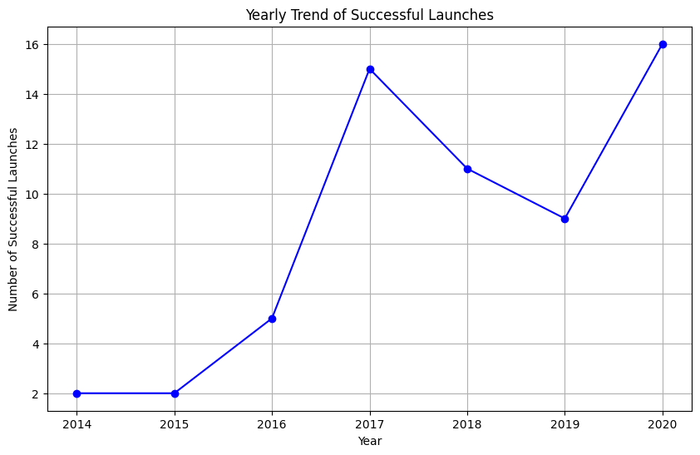
Summary of methodologies
Summary of all results
Executive Summary
Using many data collection, wrangling, and analysis techniques we determined the best way to predict the successful first stage landing of a Falcon 9 rocket and provide a dashboard for additional analysis.
To do this we used the SpaceX API, webscraping, regression, and visualization methodologies to review historical launch data and make a decision.
The results show that:
There is a positive relationship for LEO orbit and no relationship for GTO orbit
There is a positive relationship between payload weight and Polar, LEO, and ISS
Using this information, successful launches have increased from 2014 to 2020

Slide 4
Project background and context
Problems you want to find answers
Introduction
The SpaceX program aims to provide an economical edge in getting rockets into space. To do this, we have to analyze each aspect of the launch process to determine what works and what doesn’t.
To do this, we look at some of questions that need answers:
How many launches has SpaceX conducted each year?
What are the most common launch sites used by SpaceX?
What is the distribution of payload masses across all launches?
Which orbits are most frequently targeted by SpaceX launches?
What is the success rate of different booster versions?
How many times has each booster been reused?
Are there any noticeable trends or patterns in launch outcomes over time?
How has the success rate of launches evolved over the years?
How do launch outcomes vary by launch site locations (latitude and longitude)?
Can we predict the success of a launch based on features like payload mass, booster version, and launch site?

Slide 5

Section 1

Slide 6
Methodology
Executive Summary
Data collection methodology:
Data sources: APIs, Web Scraping, Databases, and Public Datasets
Tools used: Python (requests, Beautiful Soup), SQL
Perform data wrangling
Data Cleaning: Handling missing values, removing duplicates
Data Transformation: Normalization, Scaling
Perform exploratory data analysis (EDA) using visualization and SQL
Techniques: Visualization (Matplotlib, Seaborn), SQL Queries
Insights Gained: Identified patterns and trends, Detected anomalies

Slide 7
Methodology Continued
Perform interactive visual analytics using Folium and Plotly Dash
Tools: Folium (interactive maps), Plotly Dash (dashboards)
Applications: Geospatial Analysis, Dynamic data exploration
Perform predictive analysis using classification models
Models used: Reqression, SVM, Decision Trees, KNN
Evaluation Metrics: Accuracy, Precision, Recall
How to build, tune, evaluate classification models
Steps: Model selection, Hyperparameter Tuning (GridSearchCV), Cross-validation
Tools: Scikit-learn, GridSearchCV

Slide 8
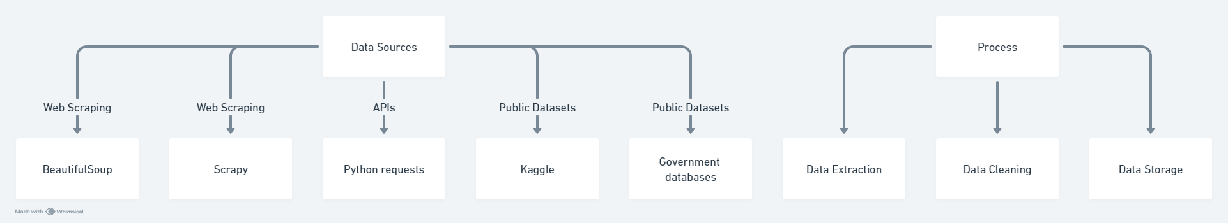
Data Collection
Web Scraping was used through automated data extraction from websites with tools BeautifulSoup and Scrapy. For example: Collecting launch details from SpaceX's official website.
APIs were used through the Python requests library. For example: Gathering real-time launch data from NASA's API.
Utilized openly available datasets like Kaggle and government databases. For example: Historical launch data from Kaggle.

Slide 9
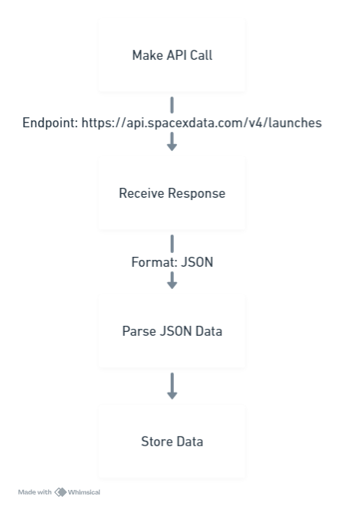
Data Collection – SpaceX API
REST API
Using SpaceX's public REST API to collect launch data to access endpoints for different data types: launches, rockets, payloads.
Tools –
Python requests library to make API calls.
JSON handling o parse and store data.
Example Endpoints:
Launch Data: https://api.spacexdata.com/v4/launches
Rocket Data: https://api.spacexdata.com/v4/rockets
Payload Data: https://api.spacexdata.com/v4/payloads
Repository can be located here:
https://github.com/kpcrash/testrepo/blob/main/jupyter-labs-spacex-data-collection-api.ipynb

Slide 10
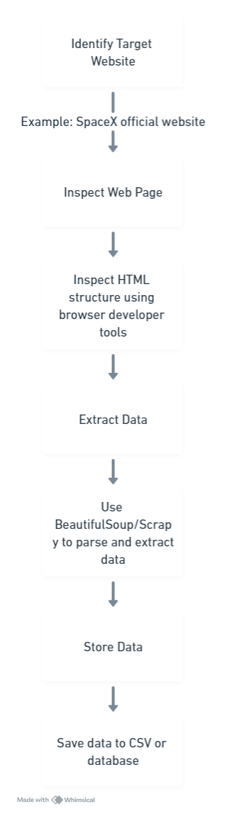
Data Collection - Scraping
Identify Target Website
Determine the website to scrape.
Example: SpaceX launch data from the SpaceX official website.
Inspect Web Page
Use browser developer tools to inspect the HTML structure.
Identify the HTML tags and classes containing the desired data.
Extract Data
Use web scraping libraries to extract data.
Tools: BeautifulSoup, Scrapy. - Parse HTML to locate and extract relevant information.
Store Data –
Save the extracted data in a structured format.
Formats: CSV, database.
Repository can be located here:
https://github.com/kpcrash/testrepo/blob/main/jupyter-labs-webscraping.ipynb

Slide 11
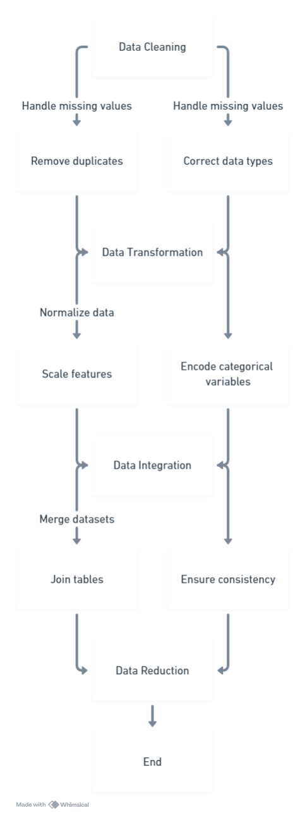
Data Wrangling
Data Cleaning
Handle missing values (e.g., imputation, removal).
Remove duplicates to ensure data integrity.
Correct data types (e.g., converting strings to dates).
Data Transformation
Normalize data to ensure consistency.
Scale features to standardize ranges.
Encode categorical variables (e.g., one-hot encoding).
Data Integration
Merge datasets from multiple sources.
Join tables based on common keys.
Ensure consistency and accuracy across datasets.
Data Reduction
Select relevant features for analysis.
Remove irrelevant or redundant data.
Aggregate data to reduce dimensionality.
Example Repositories showing data wrangling:
https://github.com/kpcrash/testrepo/blob/main/jupyter-labs-spacex-data-collection-api.ipynb
https://github.com/kpcrash/testrepo/blob/main/jupyter-labs-webscraping.ipynb
https://github.com/kpcrash/testrepo/blob/main/labs-jupyter-spacex-Data%20wrangling.ipynb

Slide 12
EDA with Data Visualization
Exploratory Data Analysis (EDA) helps in understanding the data by summarizing its main characteristics often using visual methods. Data visualization aids in identifying patterns, anomalies, and relationships within the data.
We used the following types of charts in support of this effort:
Histogram to help in understanding the spread and central tendency of the data
Box Plot to highlight the median, quartiles, and potential outliers
Scatter Plot to identify trends, correlations, and patterns between variables
Bar Chart to compare and visualize categorical data
Pie Charts to show a visual representation of the part-to-whole relationships of data
Line Charts for showing changes and trends over time
EDA Visualization Repository:
https://github.com/kpcrash/testrepo/blob/main/edadataviz.ipynb

Slide 13
EDA with SQL
Create Table: Created a table to store launch data.
Insert Data: Inserted records into the table for analysis.
Select Queries: Retrieved all records, specific columns, and filtered data based on conditions.
Aggregate Functions: Used functions like COUNT, SUM, and AVG to summarize data.
Joins: Combined data from multiple tables to enrich the dataset.
Group By: Grouped data to compute statistics for different categories.
Order By: Sorted data based on specific columns for better readability.
EDA with SQL Notebook is located here:
https://github.com/kpcrash/testrepo/blob/main/jupyter-labs-eda-sql-coursera_sqllite.ipynb

Slide 14
Build an Interactive Map with Folium
Object Type | Purpose | Why Used
Markers | Indicate specific locations on the map | Identify locations of launch sites
Circles | Highlight areas around points | Show spatial relation of launch sites
Lines | Connect multiple points on a map | Visualize connections between points
Folium map repository is located here:
https://github.com/kpcrash/testrepo/blob/main/lab_jupyter_launch_site_location.ipynb

Slide 15
Build a Dashboard with Plotly Dash
A Plotly Dashboard was created to allow for interactivity, clarity, and flexibility allowing users to drill down on details.
Dashboard contains a dropdown selector that influences a pie chart and range slider that filters data based on payload mass range shown in a scatter plot
Both dropdown and range slider inputs dynamically update the scatter plot to reflect selected filters.
Plotly Dash repository is located here:
https://github.com/kpcrash/testrepo/blob/main/spacex_dash_app.py

Slide 16
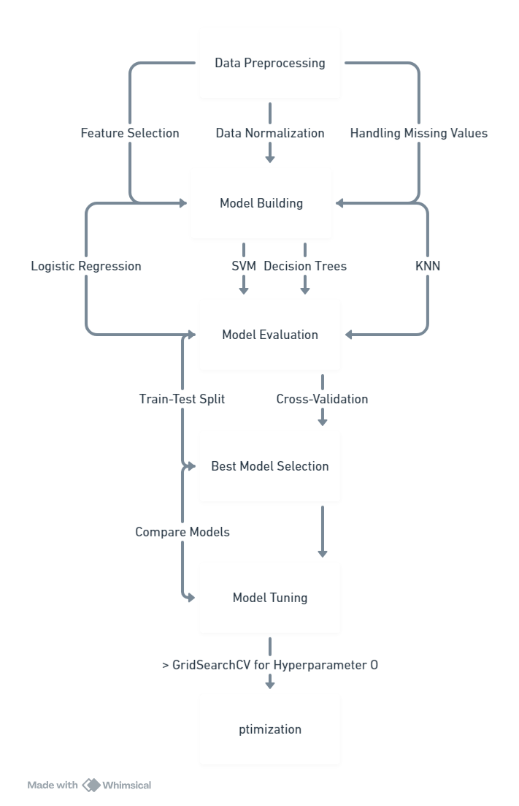
Predictive Analysis (Classification)
For predictive analysis the following steps were performed:
Data Preprocessing (Feature selection, Normalization)
Model Building (Logistic Regression, SVM, Decision Trees, and KNN)
Model Evaluation (Train-test split, Cross-validation, Accuracy, Precision, Recall, and F1-score)
Model Tuning (Hyperparameter optimization using GridSearchCV)
Model Selection (Compare evaluation metrics, select the best model)
Predictive Analysis repository is located here:
https://github.com/kpcrash/testrepo/blob/main/spacex_dash_app.py

Slide 17
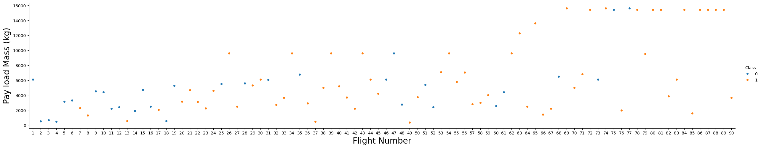
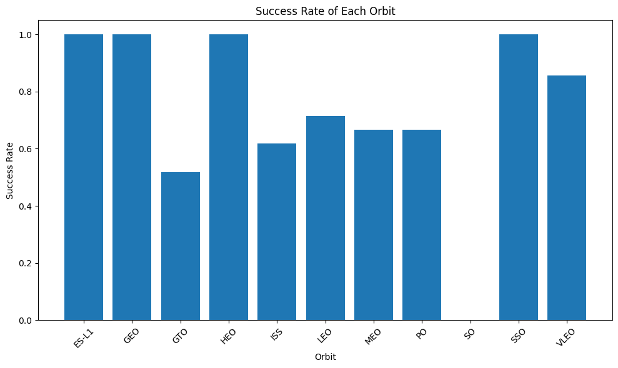
Exploratory data analysis results
Interactive analytics demo in screenshots
Predictive analysis results
EDA Results

Slide 18
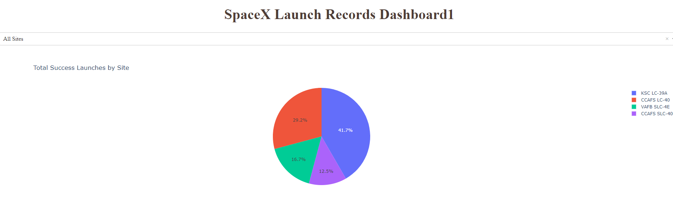
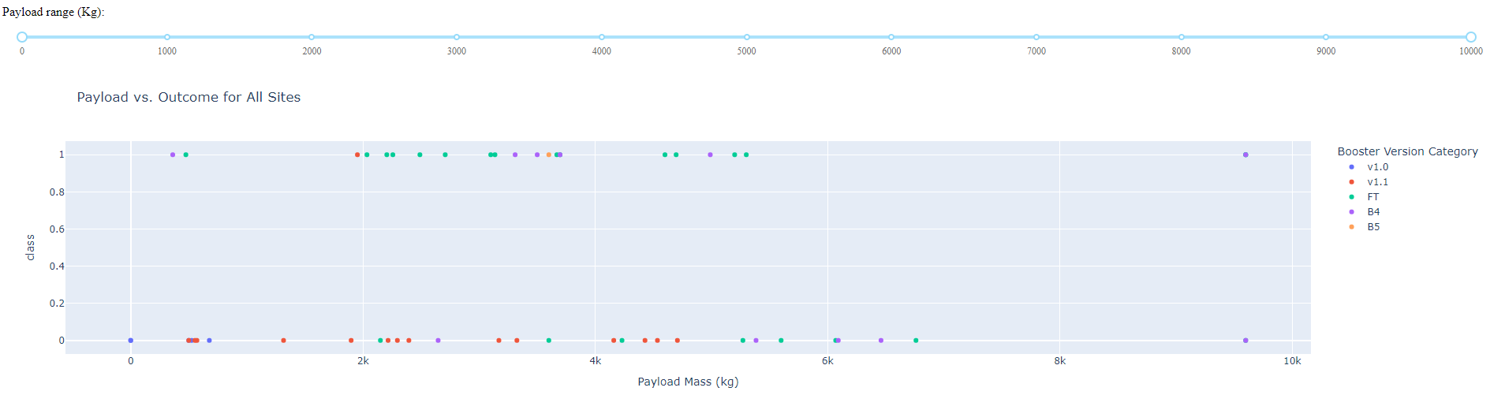
Exploratory data analysis results
Interactive analytics demo in screenshots
Predictive analysis results
Interactive Demo Screenshots

Slide 19

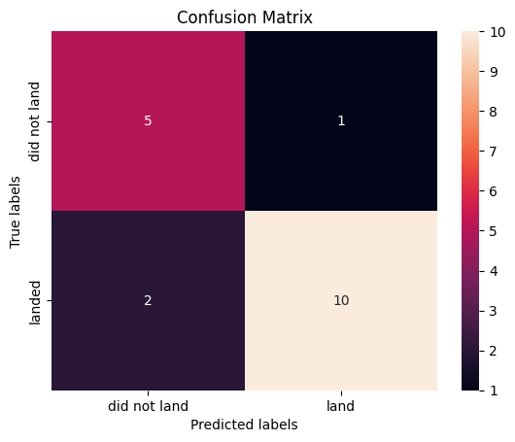
Predicitve Analysis Results
Logistic Regression Results
SVM Results
Decision Tree Results
KNN CV Results
Logistic Regression Test Accuracy: 0.8464285714285713
Support Vector Machine Test Accuracy: 0.8482142857142856
Decision Tree Test Accuracy: 0.8892857142857145
K-Nearest Neighbors Test Accuracy: 0.8482142857142858
The best performing model is Decision Tree with an accuracy of 0.8892857142857145

Slide 20

Section 2

Slide 21
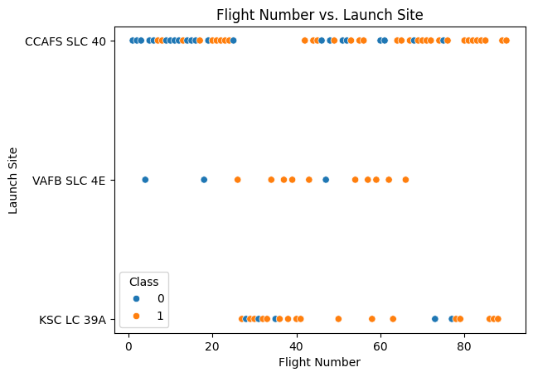
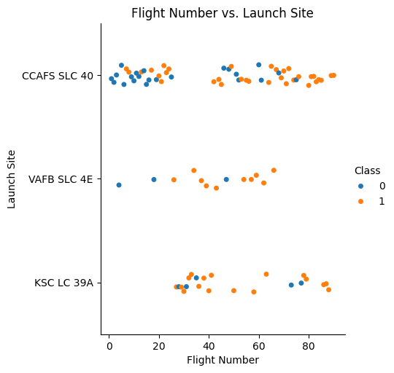
Flight Number vs. Launch Site

Slide 22
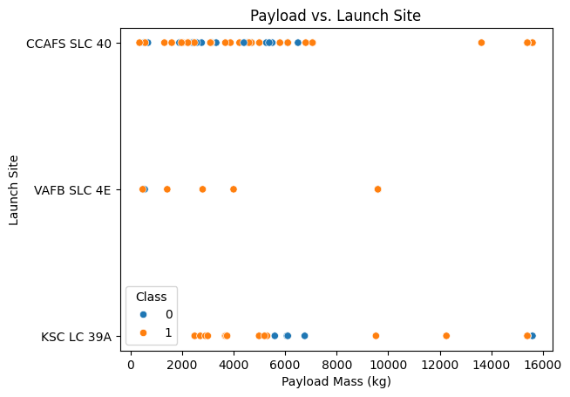
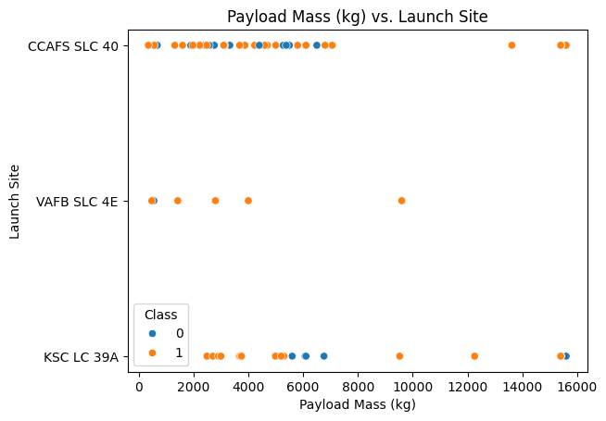
Payload vs. Launch Site
Show a scatter plot of Payload vs. Launch Site
Show the screenshot of the scatter plot with explanations

Slide 23
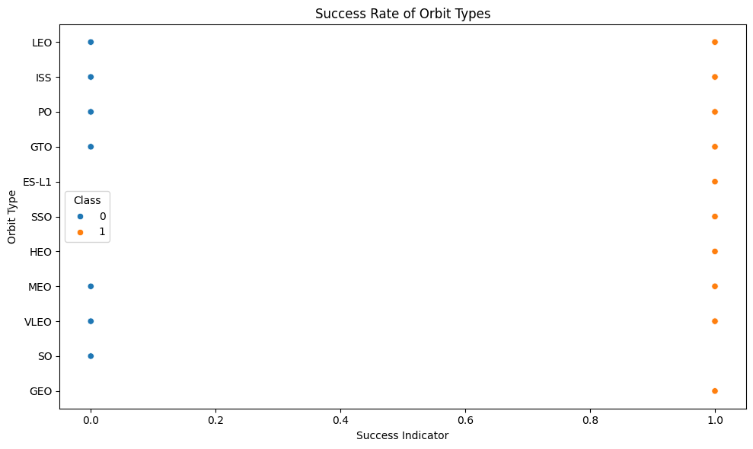
Success Rate vs. Orbit Type
Show a bar chart for the success rate of each orbit type
Show the screenshot of the scatter plot with explanations

Slide 24
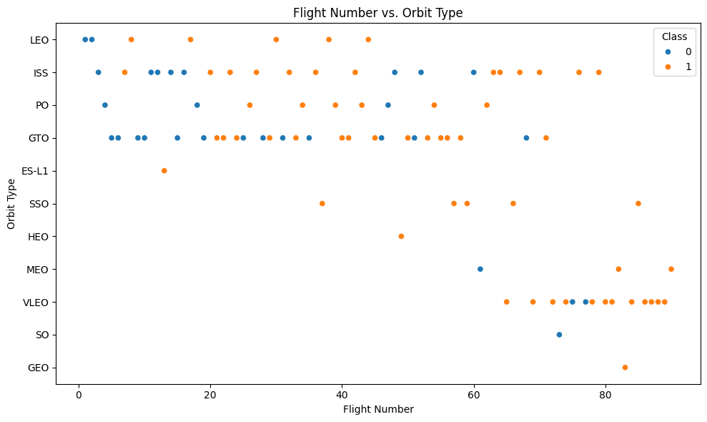

Flight Number vs. Orbit Type
Show a scatter point of Flight number vs. Orbit type
Show the screenshot of the scatter plot with explanations

Slide 25
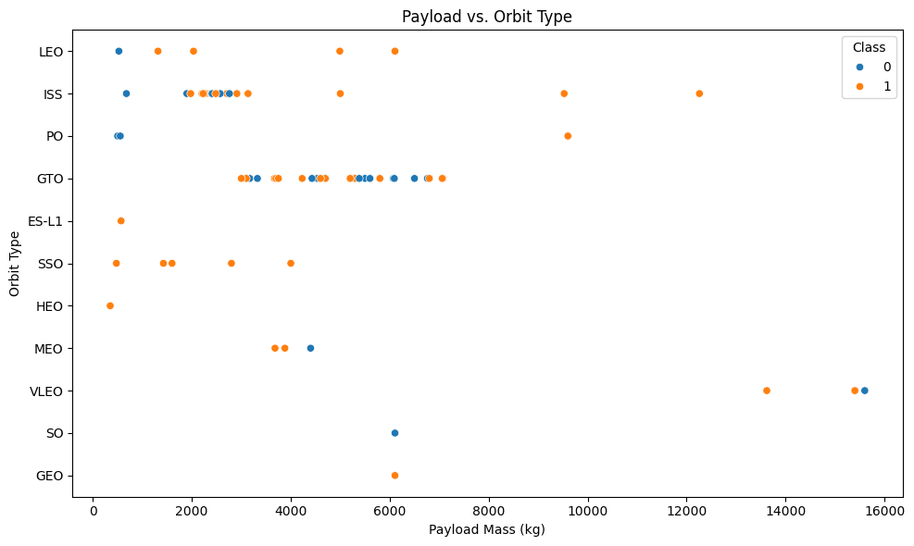
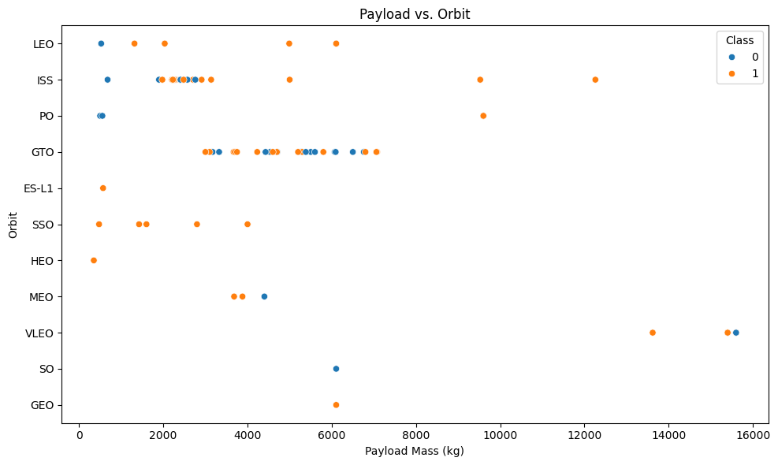
Payload vs. Orbit Type
Show a scatter point of payload vs. orbit type
Show the screenshot of the scatter plot with explanations

Slide 26

Launch Success Yearly Trend
Show a line chart of yearly average success rate
Show the screenshot of the scatter plot with explanations

Slide 27
All Launch Site Names
Find the names of the unique launch sites
Present your query result with a short explanation here
%sql select distinct "Launch_Site" from SPACEXTABLE (Uses distinct to limit to the unique names)
Launch_Site
CCAFS LC-40
VAFB SLC-4E
KSC LC-39A
CCAFS SLC-40

Slide 28
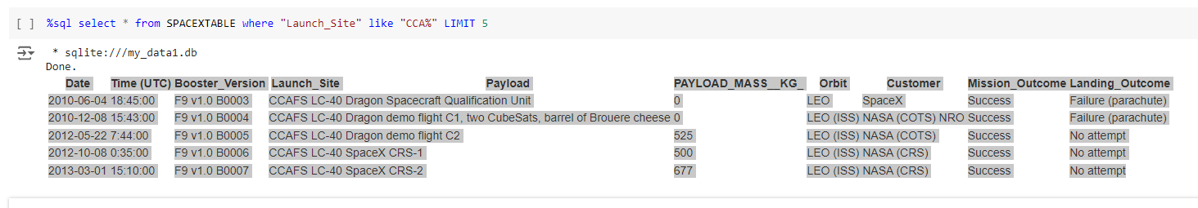
Launch Site Names Begin with 'CCA'
Find 5 records where launch sites begin with `CCA`
This query uses the limit function to reduce the results to the first 5 records.

Slide 29
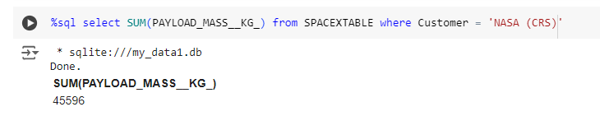
Total Payload Mass
Calculate the total payload carried by boosters from NASA
This query uses the SUM function to calculate a total

Slide 30
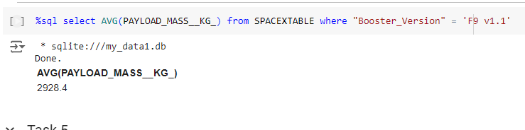
Average Payload Mass by F9 v1.1
Calculate the average payload mass carried by booster version F9 v1.1
This query uses the AVG function to calculate an average

Slide 31
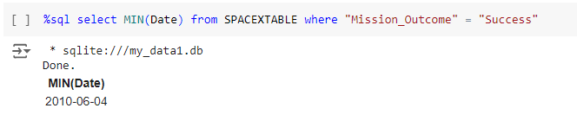
First Successful Ground Landing Date
Find the dates of the first successful landing outcome on ground pad
This query uses a where clause and the MIN function to determine the result

Slide 32
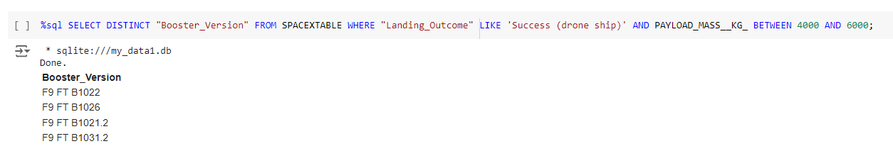
Successful Drone Ship Landing with Payload between 4000 and 6000
List the names of boosters which have successfully landed on drone ship and had payload mass greater than 4000 but less than 6000
This query uses distinct, a where clause, and a between predicate to get the results

Slide 33
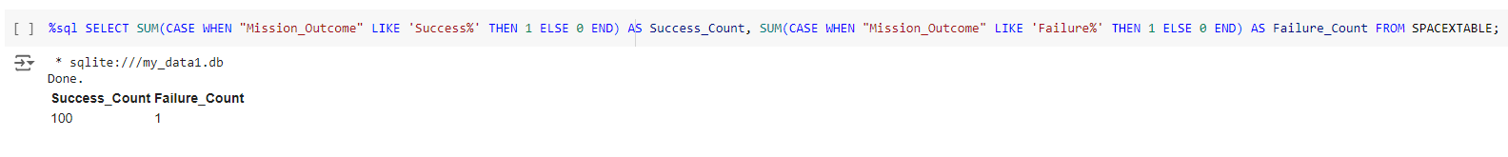
Total Number of Successful and Failure Mission Outcomes
Calculate the total number of successful and failure mission outcomes
This query combines the SUM function with LIKE clauses and aliasing to determine the result

Slide 34
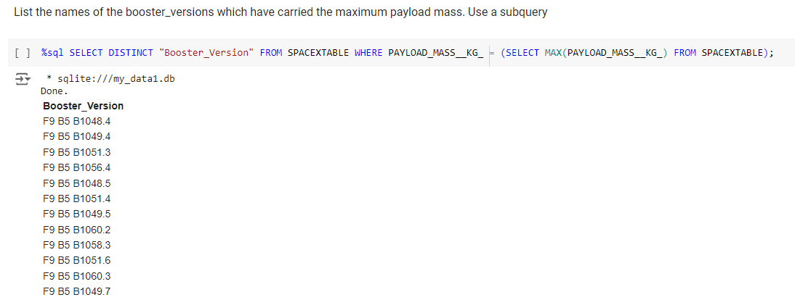
Boosters Carried Maximum Payload
List the names of the booster which have carried the maximum payload mass
This query uses a subquery to provide results based on a distinct booster version

Slide 35
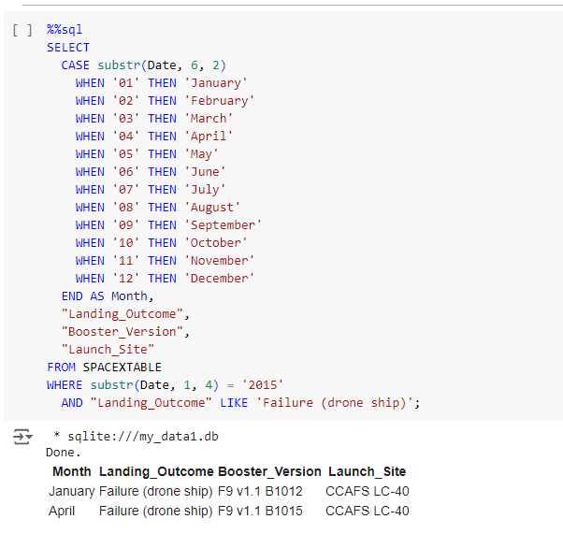
2015 Launch Records
List the failed landing_outcomes in drone ship, their booster versions, and launch site names for in year 2015
This query requires a custom date function.
It then uses a where clause with that function to illustrate a result

Slide 36
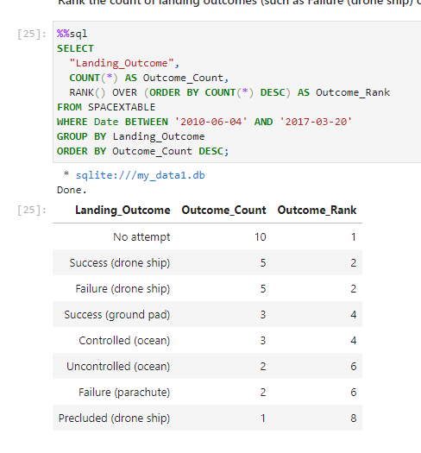
Rank Landing Outcomes Between 2010-06-04 and 2017-03-20
Rank the count of landing outcomes (such as Failure (drone ship) or Success (ground pad)) between the date 2010-06-04 and 2017-03-20, in descending order
This query uses COUNT and RANK functions to produce the results.

Slide 37

Section 3

Slide 38
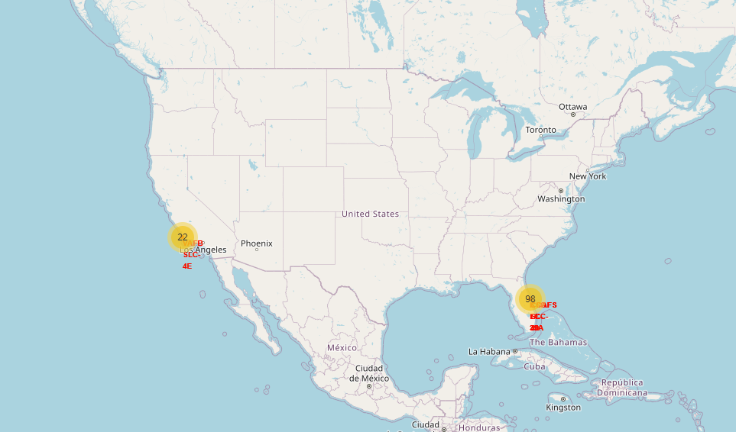
Launch Site Map
Explain the important elements and findings on the screenshot:
This map shows where all of the SpaceX launch sites are and that they are all located near a coastline.

Slide 39
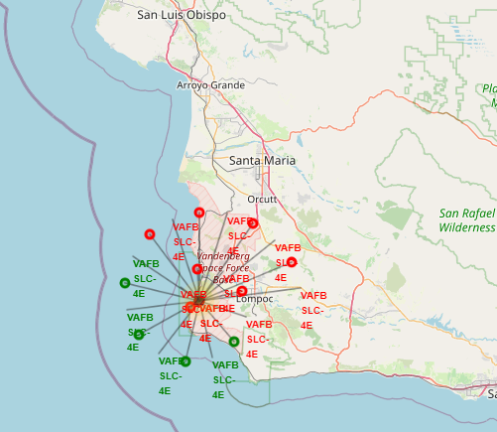
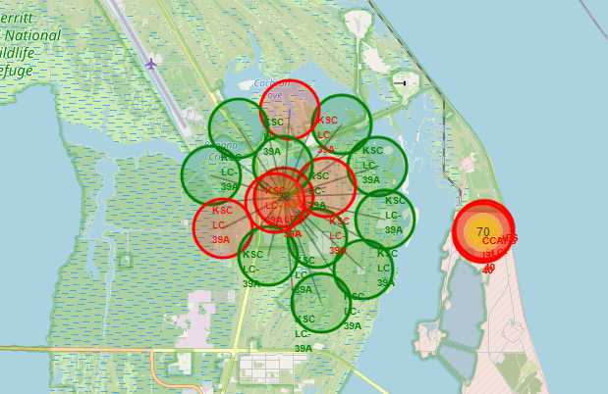
Launch Outcomes by Site
Explain the important elements and findings on the screenshot
These images show the success or failure rate at each location as indicated by red (failure) or green (success) markers

Slide 40
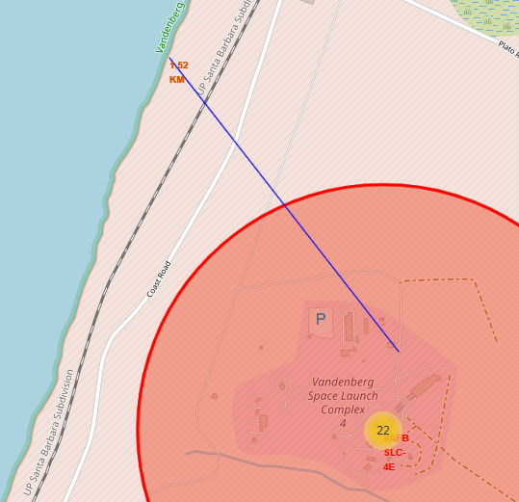
Proximity of Launch Site to Coastline
This shot shows the proximity of the coastline to the launch site. It also goes over a railroad showing how launch site activities can impact surrounding elements.

Slide 41

Section 4

Slide 42
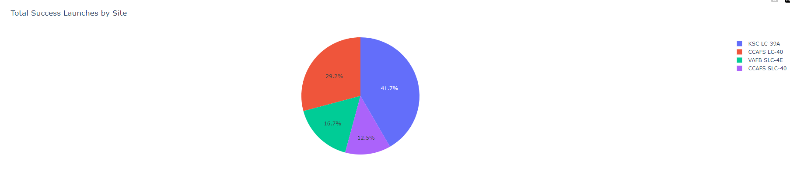
Successful Launches by Site
This pie chart shows the percentage of total successes by launch site:

Slide 43
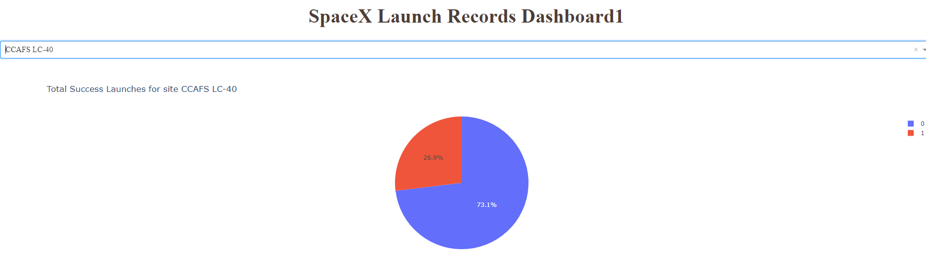
Highest Success Ratio for a site
This shows the highest success rate for the sites and that the best success is had at CCAFS LC-40

Slide 44
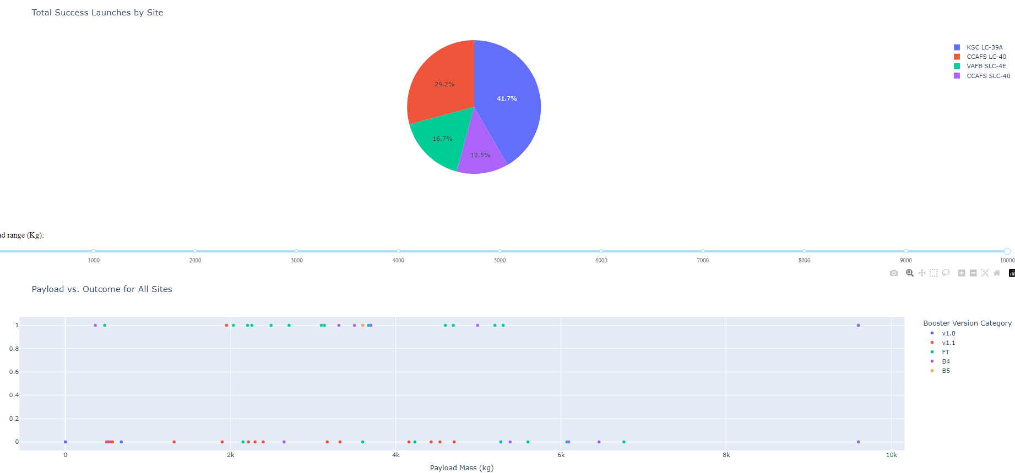
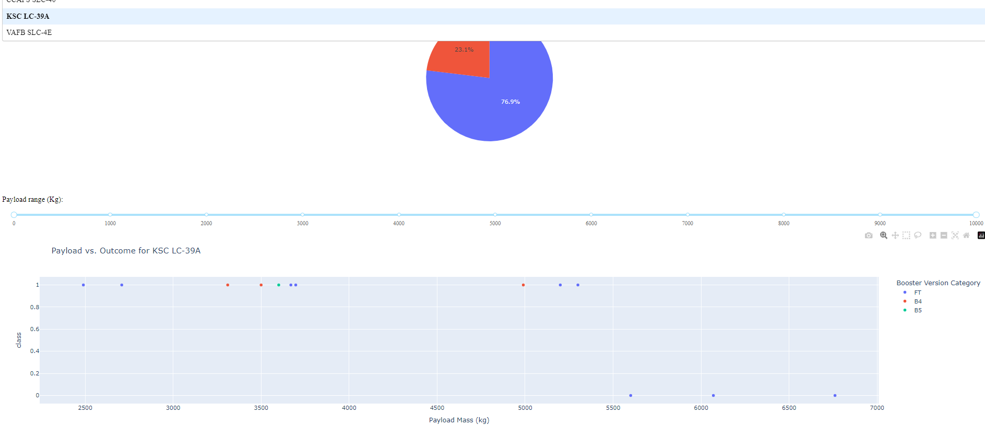
The Impact of Payload on Success
These findings show how the payload impacts the success rate of specific booster versions across sample sites.

Slide 45

Section 5

Slide 46
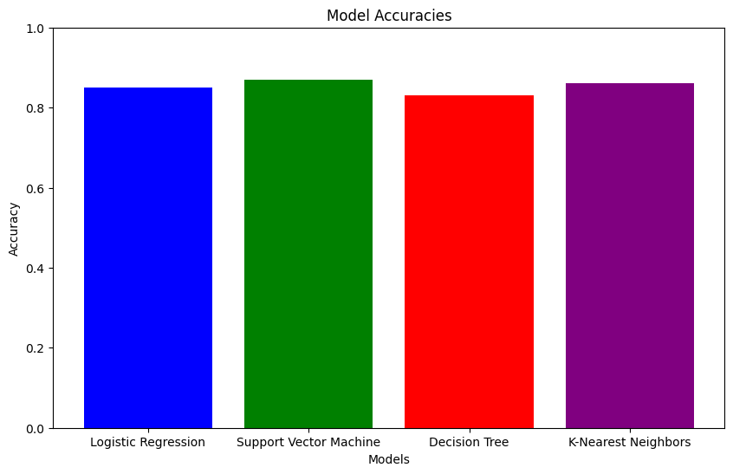
Classification Accuracy
Logistic Regression Test Accuracy: 0.8464285714285713
Support Vector Machine Test Accuracy: 0.8482142857142856
Decision Tree Test Accuracy: 0.8875
K-Nearest Neighbors Test Accuracy: 0.8482142857142858
The best performing model is Decision Tree with an accuracy of 0.8875

Slide 47
Confusion Matrix of Best Model
Components of the Confusion Matrix:
True Positives (TP): Correctly predicted positive instances.
True Negatives (TN): Correctly predicted negative instances.
False Positives (FP): Incorrectly predicted positive instances (Type I error).
False Negatives (FN): Incorrectly predicted negative instances (Type II error).

Slide 48
Conclusions
We discovered that:
Optimizing payload configurations to ensure higher success rates. Heavier payloads might have different success probabilities compared to lighter ones.
We need to enhance facilities and processes at launch sites with lower success rates. Different launch sites show varying success rates, likely due to geographical, technical, and logistical factors.
We need to invest in booster technologies and refine reuse protocols to maximize launch success. This is because the reuse and type of boosters significantly impact the outcome
By understanding which factors most affect success rates, SpaceX can allocate resources more effectively, focusing on optimizing crucial aspects such as payload configurations and launch preparations at specific sites.

Slide 49
Appendix
Please review files in the repository at https://github.com/kpcrash/testrepo/tree/main for further information.
Thank you.

Slide 50


